Slide 1
Visual Grammar
Lucy Cook
IXD303 Designing User experiences

Slide 2
Ixd303 BRIEF
The brief for this module is to ideate and design an online learning platform to teach people about UX design. Examining the current educative landscape and building on what could be the Monzo of UX education.

Slide 3
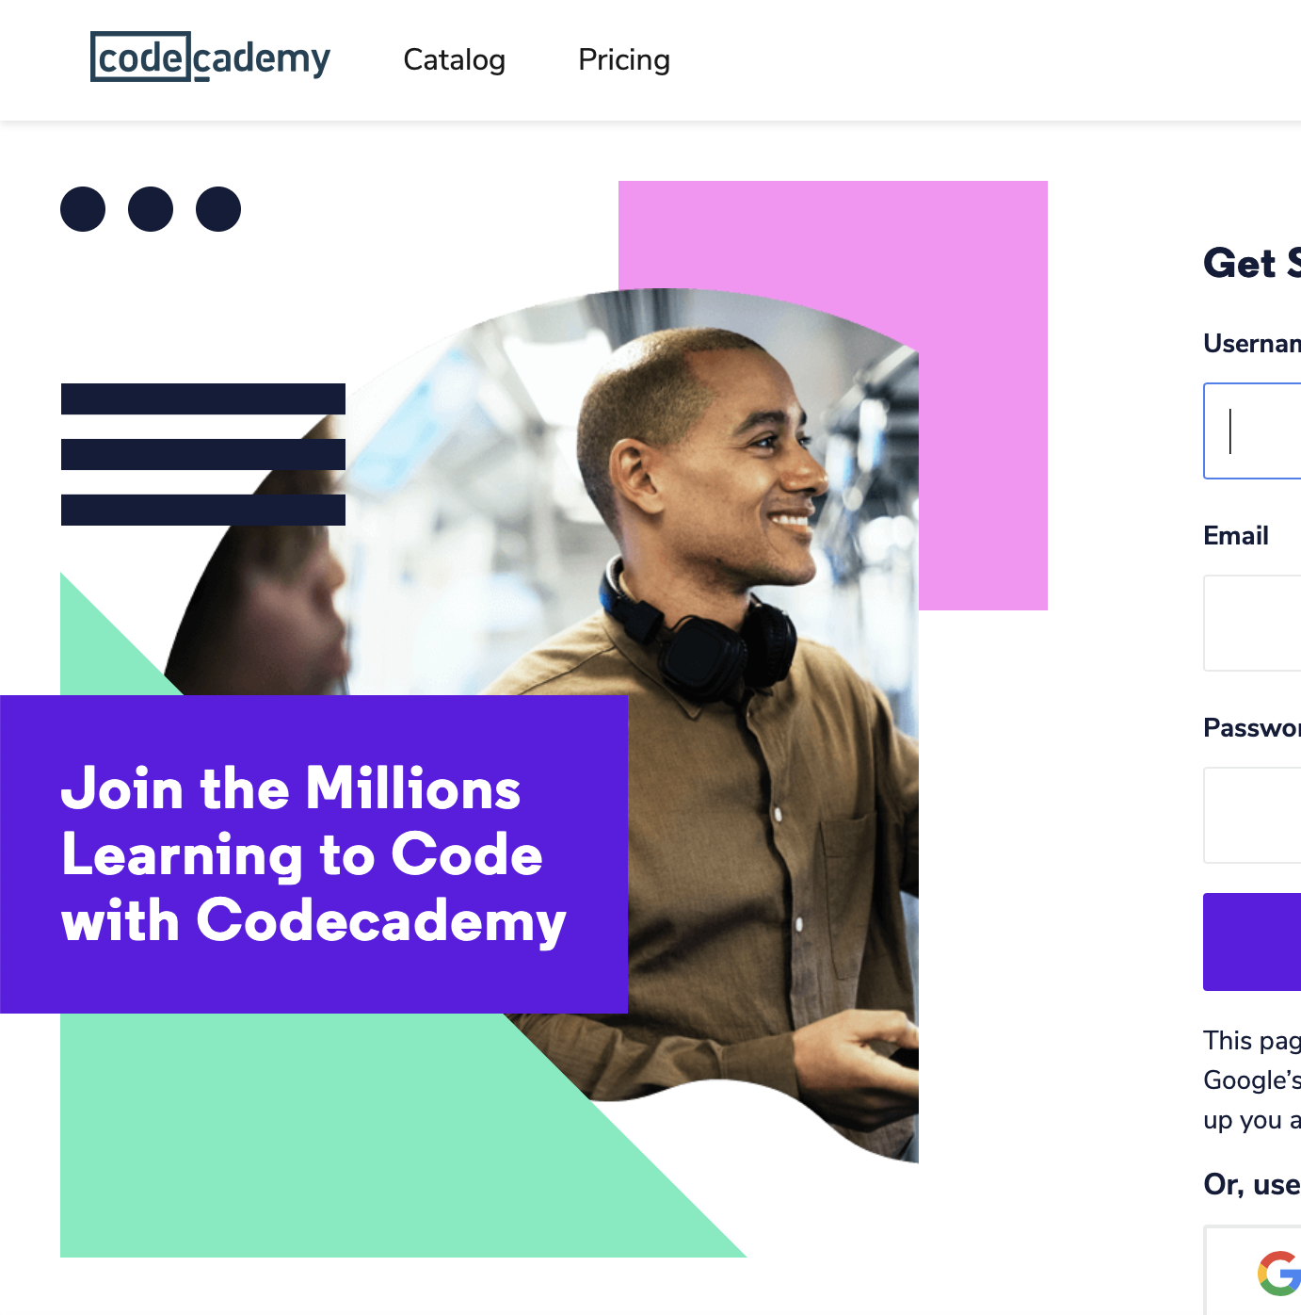


Product dna
After extensive competitor benchmarking, here’s a look at my top 3 online learning platforms I wish to draw inspiration from:
FutureLearn – for the course structure, strong brand colour and iconography, Thinkful – for the heavy use typography and illustrations following a simplistic design, Codeacademy – for the course structure, encouraging language, colour and illustrations.
Notes:
After a considerable amount of research looking at different platforms, I picked the top 3 I took the most inspiration from. Looking at Codeacademy, FutureLearn and Thinkful.

Slide 4
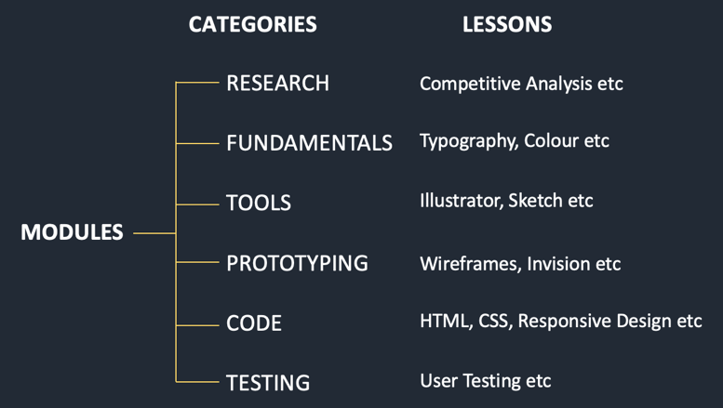
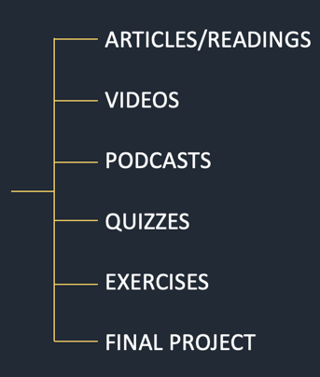
Content structure
TASKS
In terms of content structure, each module will be categorised by 6 module headings, each student can follow the process from start (Research) through to finish (Testing) or they have to option to simply navigate through to find the course that suits them with the help of the categorised headings. Each module has it’s own set of tasks delivered by different mediums, a student must complete every task outlined in order to complete the module.
Notes:
In terms of content structure for my product. I set it out so that each module is categorised by 6 module headings for the purpose of effective structure to my site, each student can follow the process from start (Research) through to finish (Testing) or they have to option to easily navigate through to find the course that suits them with the help of headings. Each module has it’s own set of tasks delivered by different mediums, a student must complete every task outlined in order to complete the module.

Slide 5

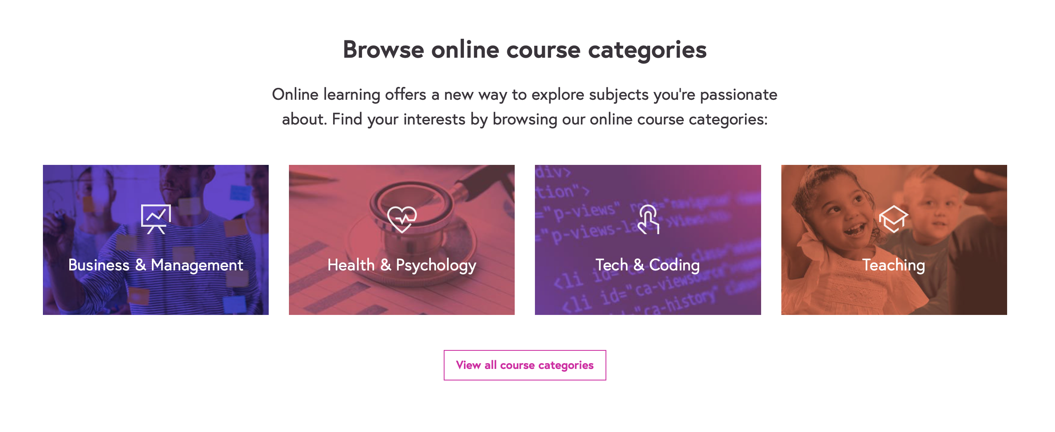

Content structure (and visual aesthetic)
codeacademy
futurelearn
Thinkful
Both Futurelearn and Codeacademy have a similar content layout, in that they have grouped individual modules into different categories. Grouping content makes for easier navigation and for the purpose of my pattern concept which I explain later. As you can see from my 3 chosen websites I’m very favourable to using colour and iconography/illustrations in order to make the web content more visually appealing and I believe easier to use.
Notes:
Both futurelearn and code academy have a similar content layout, in that they have grouped individual modules into different categories.
The reason for grouping my content is for easier navigation because that is what I often found difficult when researching different platforms.
However I also grouped the content for the purpose of my pattern concept which I’ll explain as we go on.
As you can see from my 3 chosen websites I’m very favourable to using colour and iconography/illustrations in order to make the web content more visually appealing and I believe easier to use.

Slide 6
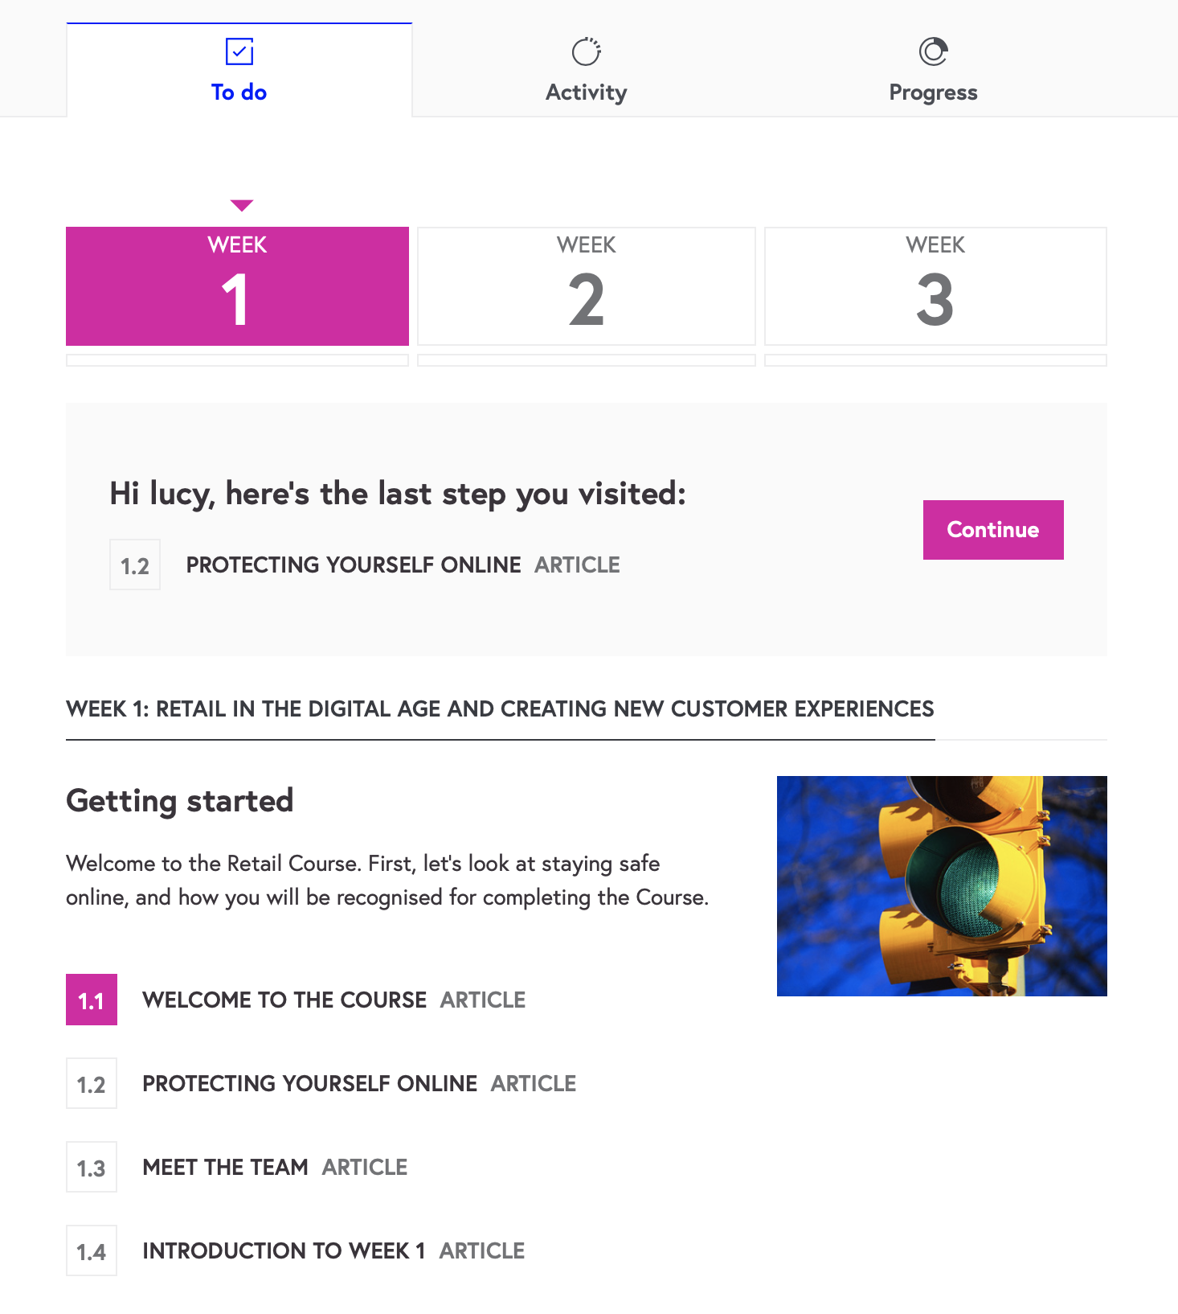
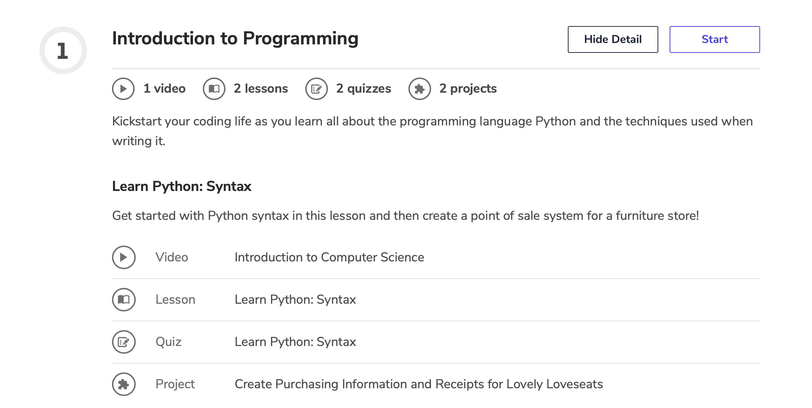
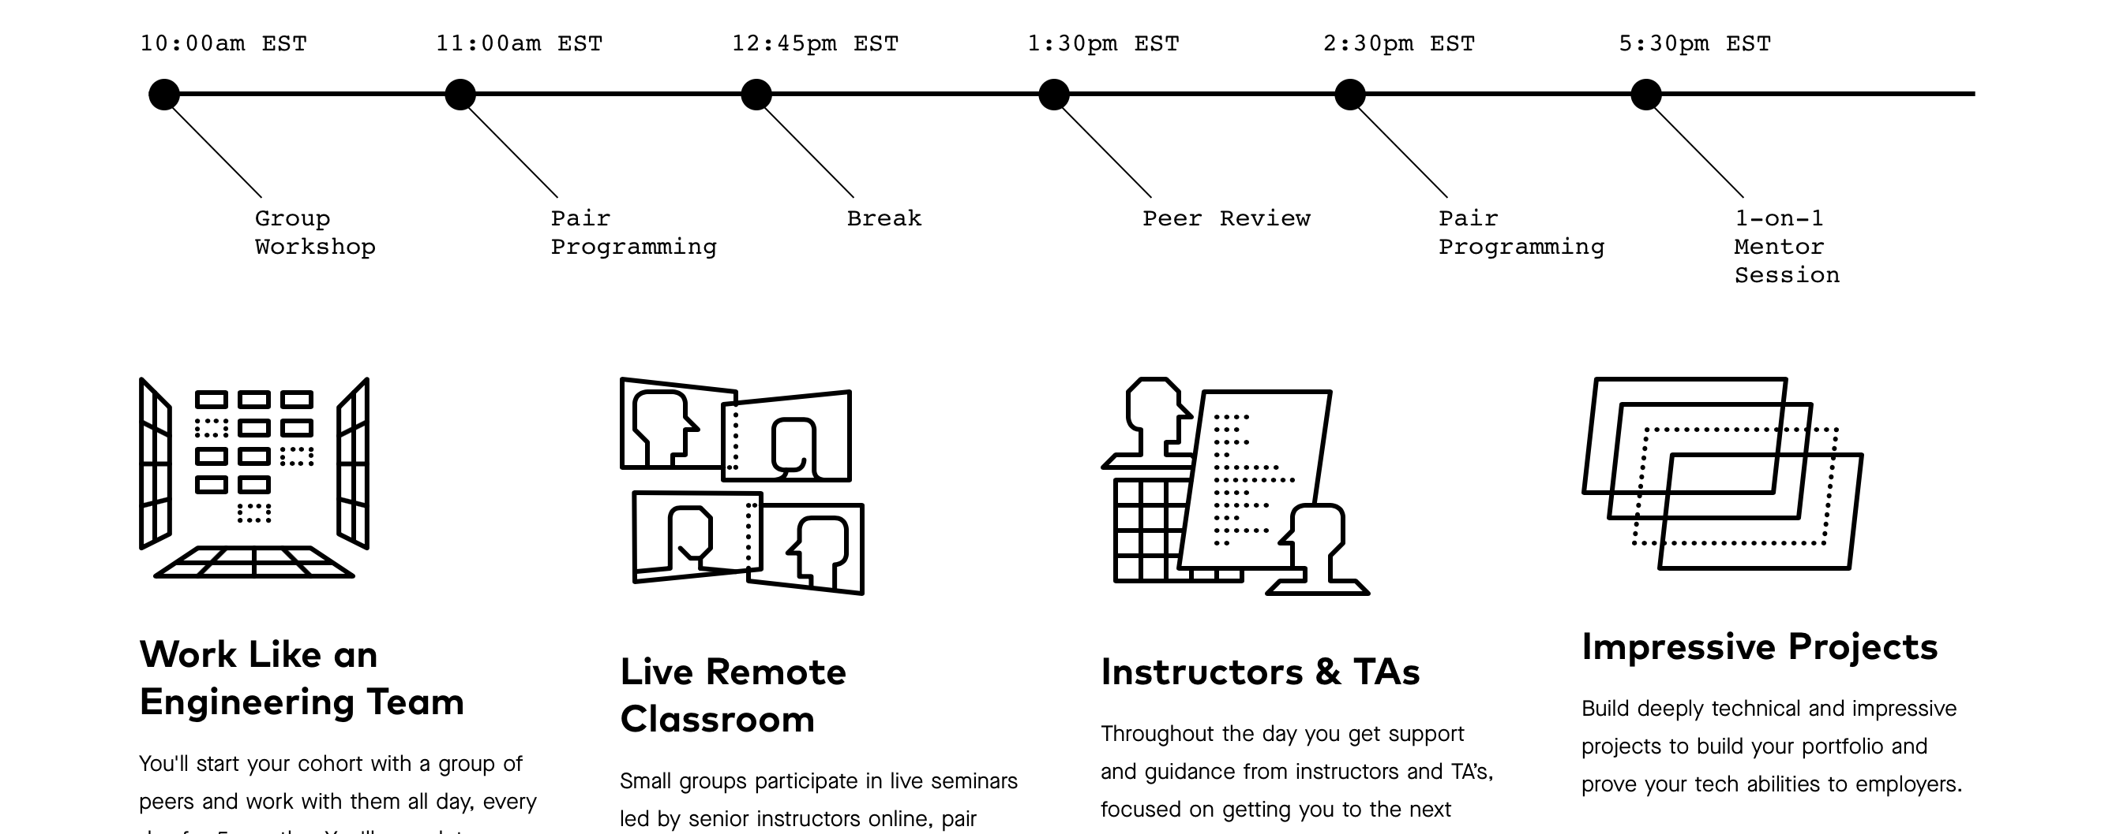
task structure
futurelearn
codeacademy
Thinkful
In terms of task structure, the most effective layout is a clear and simple timeline, that will outline in order the tasks of each module as well as how that particular content is delivered so that they student knows exactly what and how they will be learning before they begin.
Notes:
In terms of task structure, the most effective layout is a clear and simple timeline that will outline the clear tasks of each module in order and how that particular content is delivered so that they student knows exactly what they are expected of before they dive into learning.

Slide 7
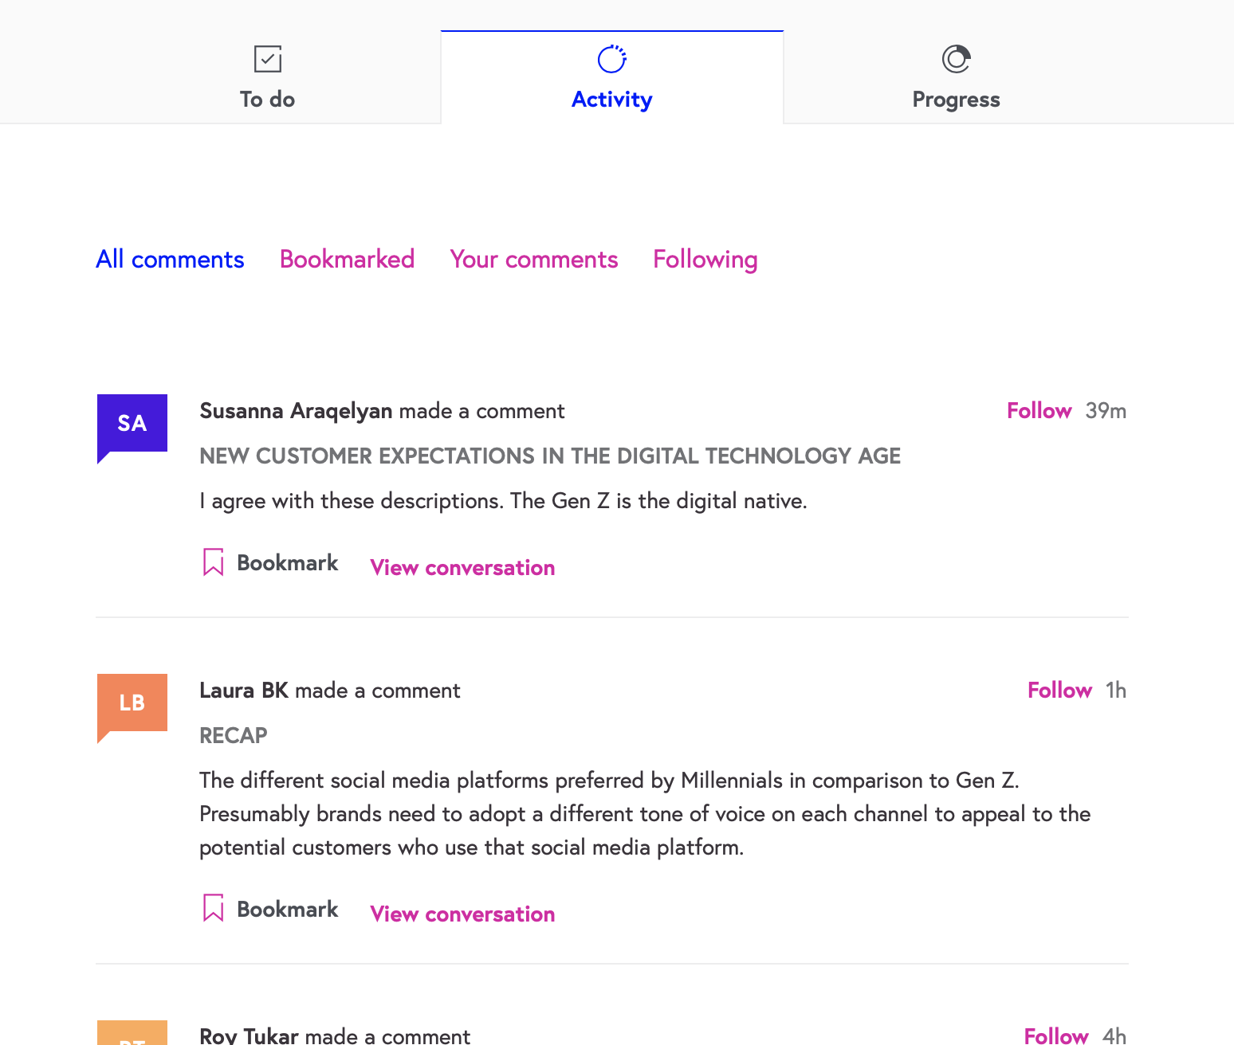
community
futurelearn
1 tutor to
1 module
1 community to
1 module
There will always be an underlying issue with communication because in the end you are still being taught through a computer screen. However ways to improve would be to assign 1 tutor to 1 module, therefore they deal with just those students currently undertaking a module in terms of providing feedback etc. Similarly with access to fellow students, I believe it would be more controllable having a community section per module so that those students are discussing the same areas.
Notes:
From looking at other online learning platforms, there seems to be a consistent issue with access to tutors or even other students. I feel as though there will always be an underlying issue in this area because in the end you are still being taught through a computer screen rather than in a classroom. However ways to improve interactivity between tutors and fellow students in my opinion would be to assign 1 tutor to 1 module, therefore they deal with all the students currently undertaking a module in terms of providing feedback etc. Same with access to fellow students, I believe it would be more controllable having a community section per module so that those students are discussing the same areas.
Perhaps incorporating something similar to what FutureLearn provide in that anyone can comment under a particular module and receive answers from fellow students.

Slide 8
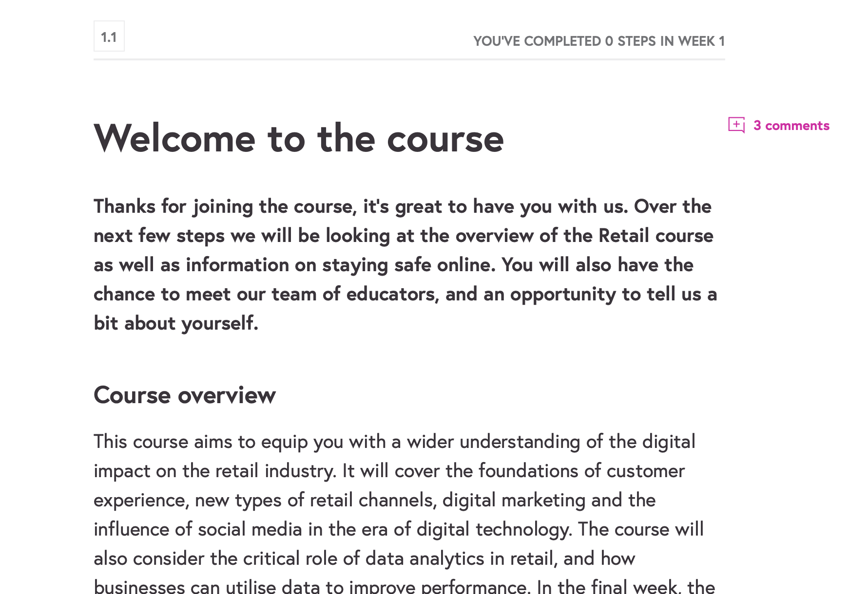
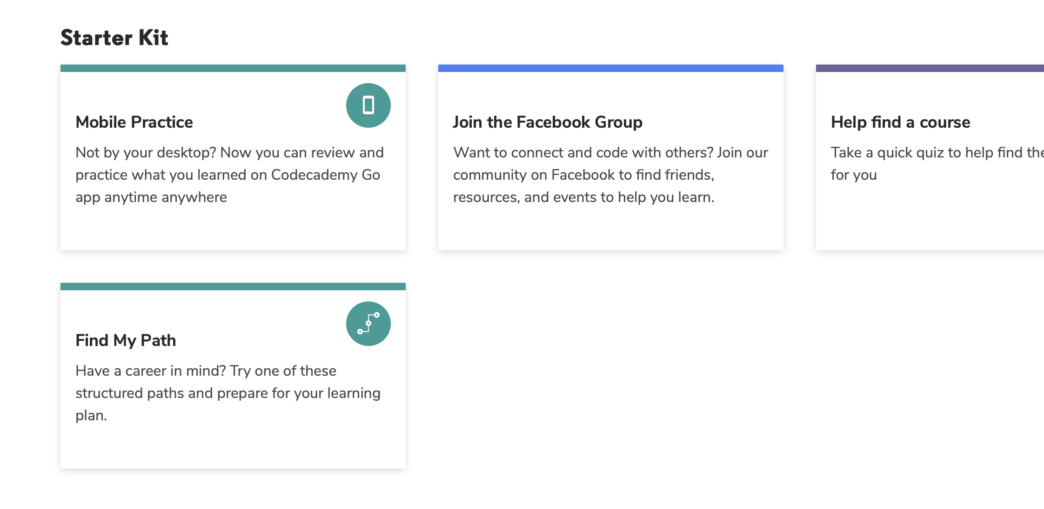
Profile induction
futurelearn
codeacademy
I think it’s important when a user signs up that they are provided with some sort of welcome/introduction, like an on boarding experience, so that they can get to know how to navigate through the site and understand the purpose of different features as I believe I have a number to offer.
Notes:
I think it’s important when a user signs up that they are provided with some sort of welcome explanation, like an on boarding experience, so that they can get to know how to navigate through the site and understand the purpose of different features as I believe I have a number to offer.

Slide 9
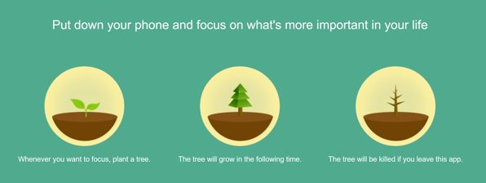
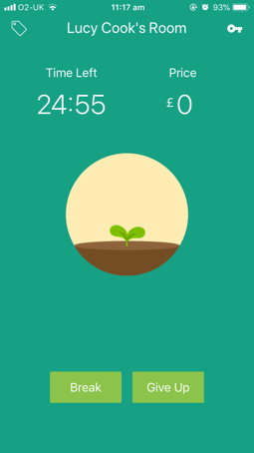
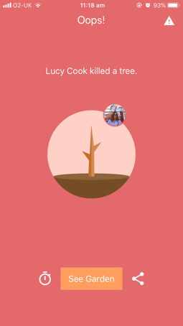
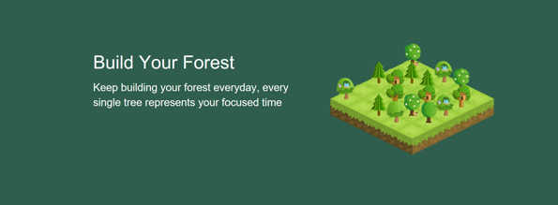
Tracking process
forest
Forest is an app that helps you to put down your phone and successfully learn, you must stay on the app on order to successfully grow a tree which ultimately stops you from getting distracted by using your phone. After a set amount of time, you will have grown a tree that is then added to your personal forest. Online learning can be very distracting, therefore introducing this concept was very intriguing to me. I came up with a similar idea, using a pattern that can grow as you develop rather than a tree.
Notes:
Forest is an app that helps you to put down your phone and successfully learn, you must stay on the app on order to successfully grow a tree which ultimately stops you from getting distracted by using your phone. After a set amount of time, you will have grown a tree that is then added to your personal forest.
Online learning can be very distracting when there are so many more interesting things to find on the internet, therefore introducing this concept was very intriguing to me. I came up with a similar idea, using a pattern that can grow as you develop rather than a tree.

Slide 10
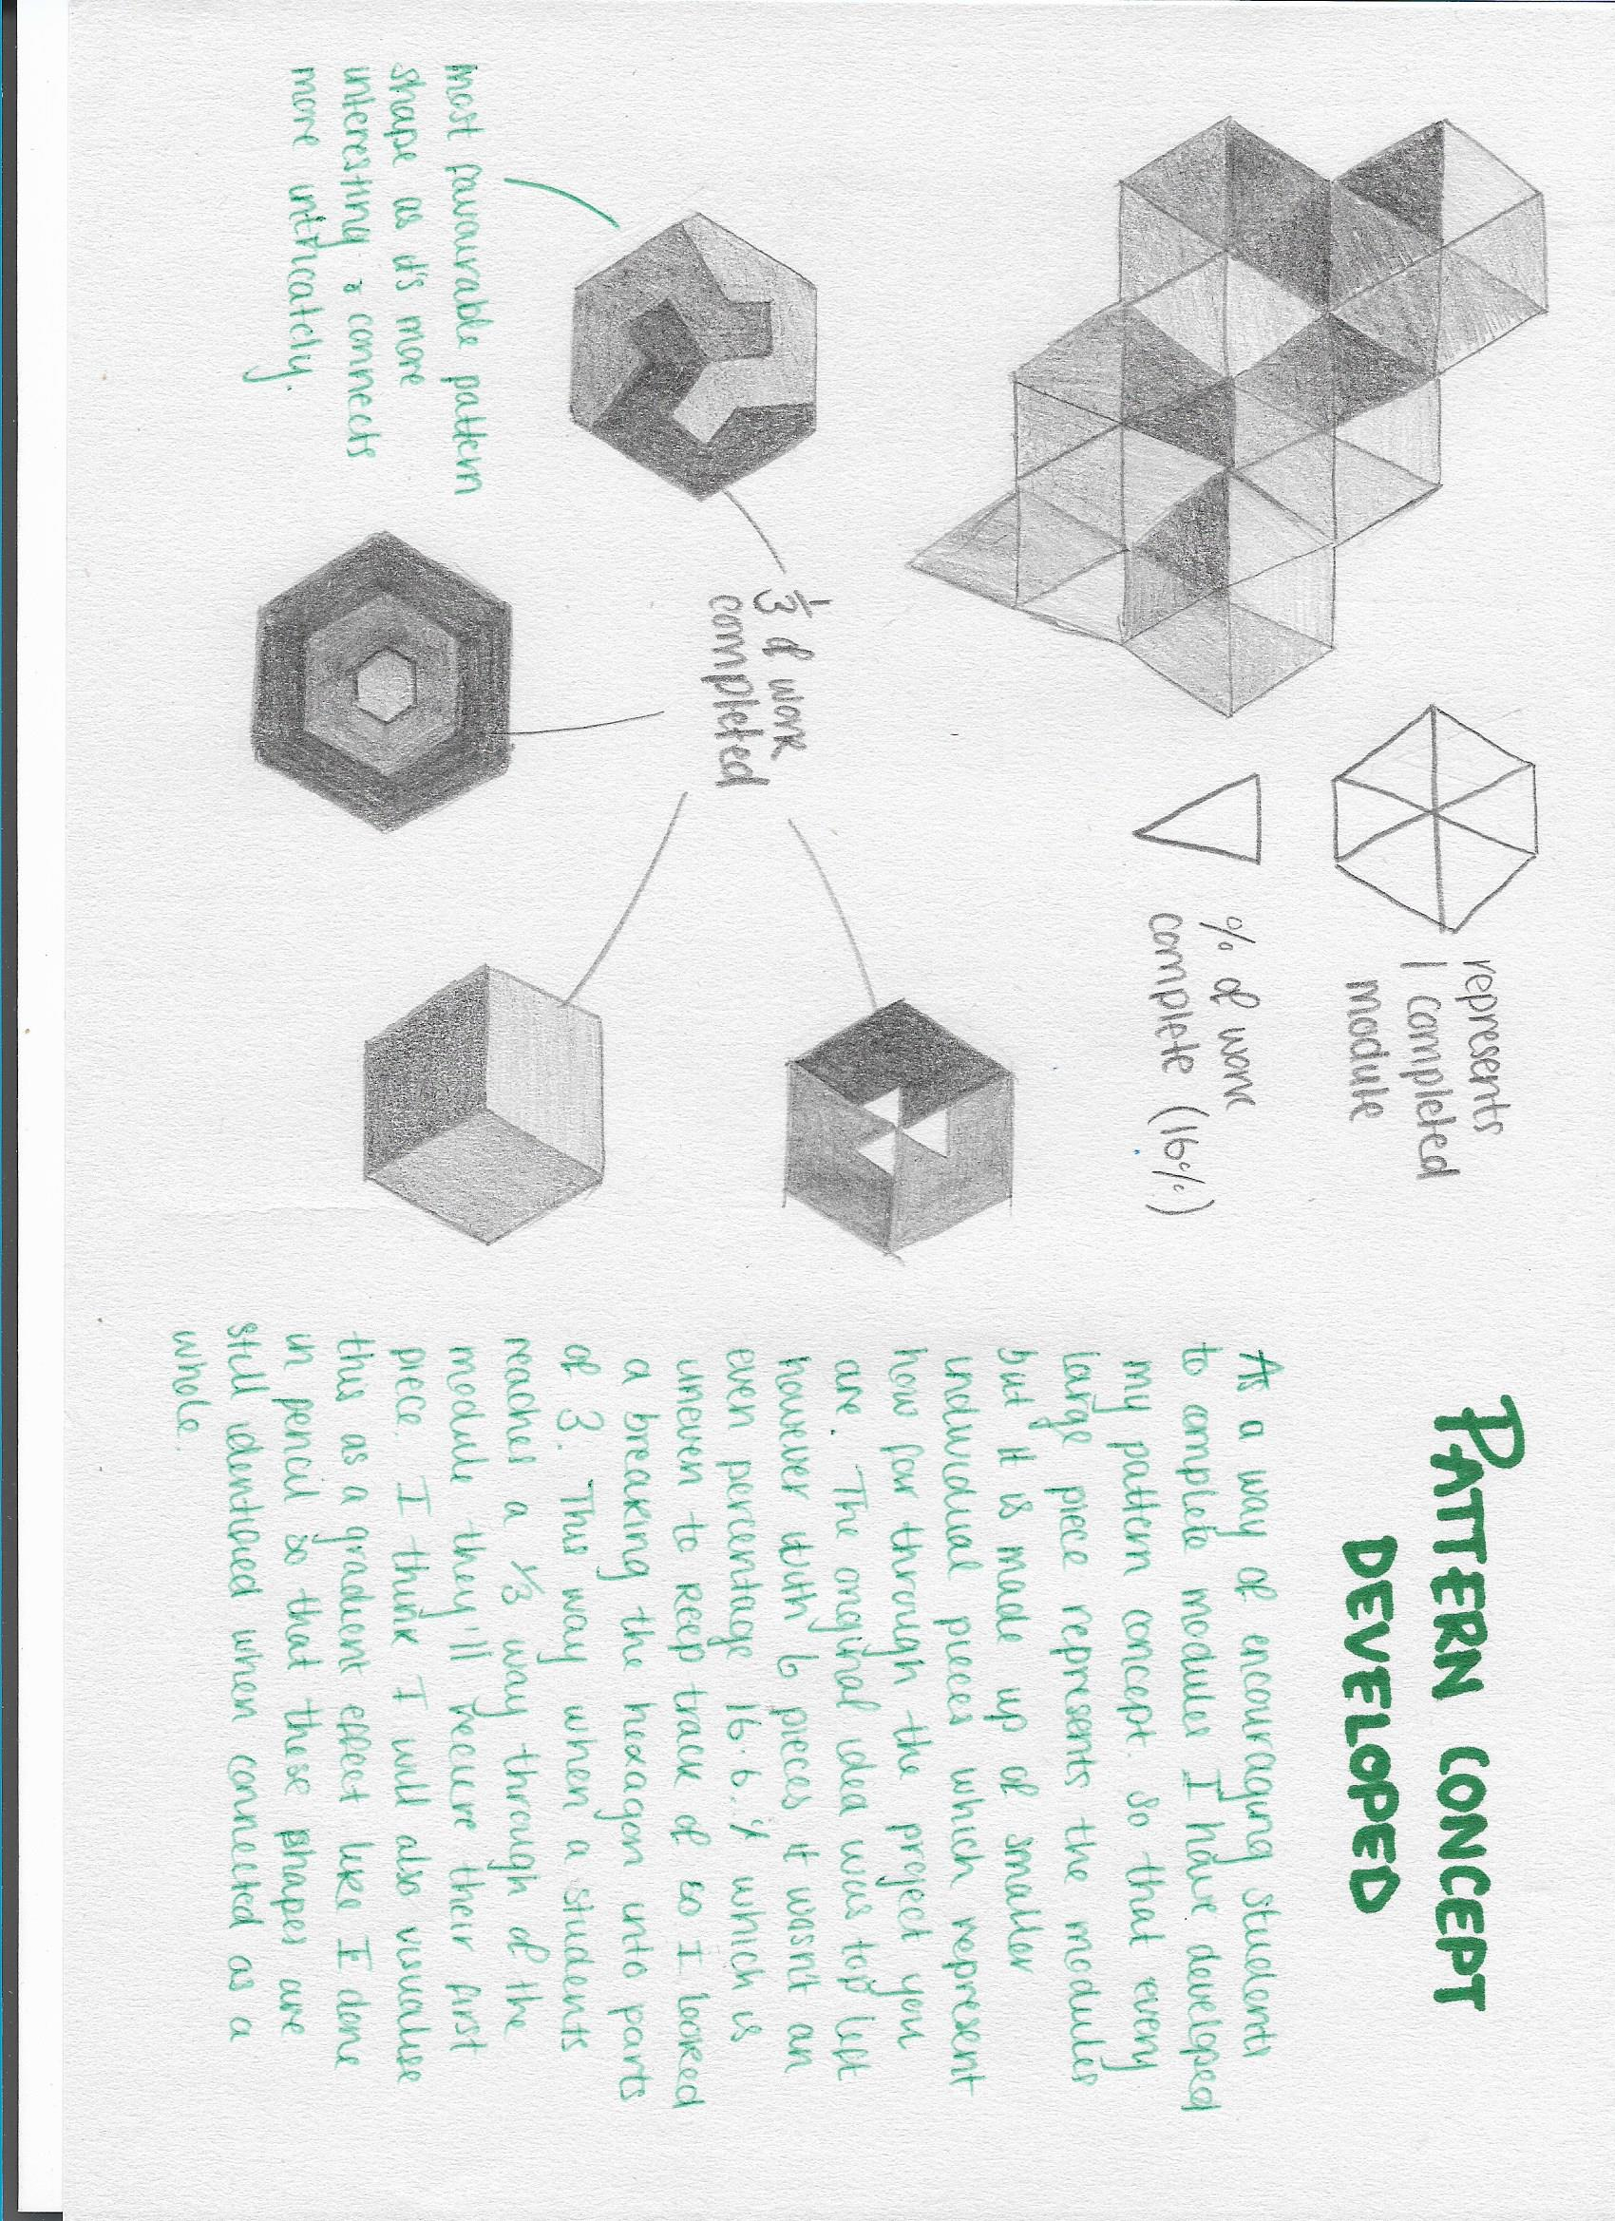
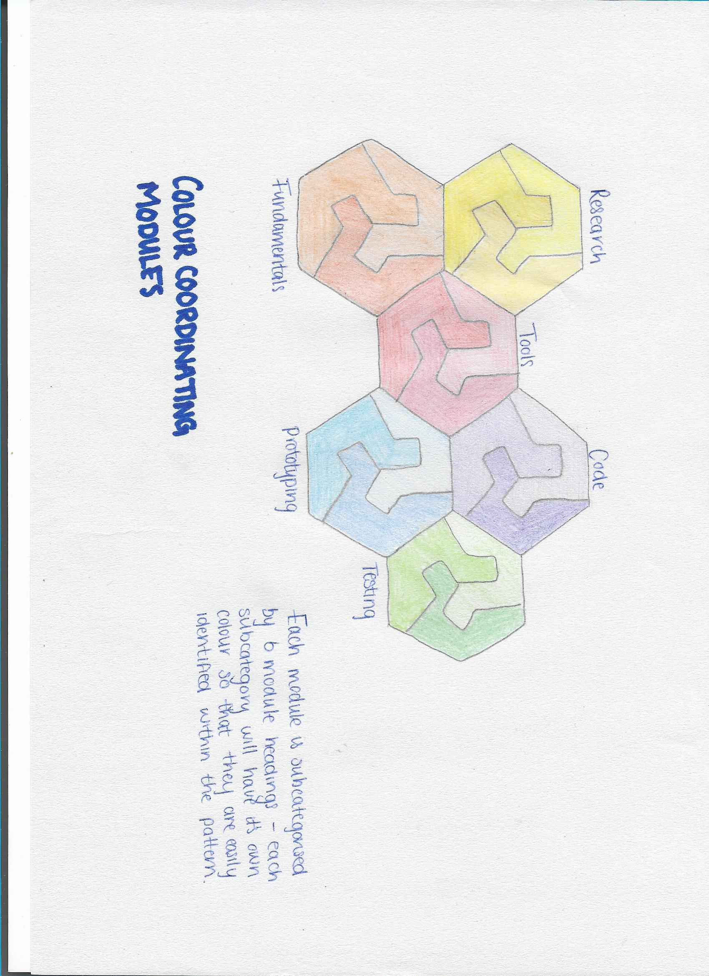
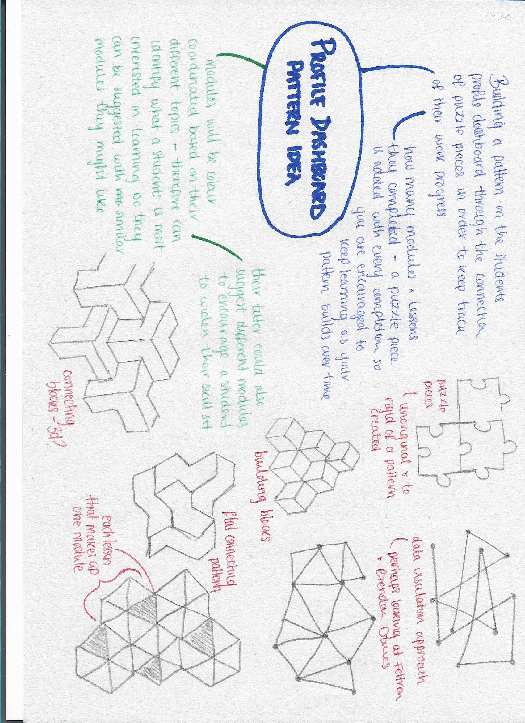
Pattern and rewarding concept
I want users to be able to build their own pattern, as a means of tracking their progress. One ‘puzzle’ will represent a module, made up of individual ‘puzzle pieces’ representing the task within a module. Students receive a ‘puzzle piece’ with every task completion encouraging them to keep learning and build on their pattern, similar to building a forest. Each module will be colour coordinated based on their different sub categories.
Notes:
My concept is to use a puzzle piece shape, that connects to other pieces so in the end you can produce an overall pattern. One ‘puzzle piece’ will represent a module, and so a new ‘puzzle piece’ will be added with every completion the student achieves. This encourages them to keep learning and build on their pattern, similar to building their forest.
I then developed this idea further so that the large shape is made up of individual pieces which would track for how far you are into the module – receiving a smaller individual piece for every task that is completed.
Each module will be colour coordinated based on their different sub categories (for example all coding modules will be purple, all prototyping modules will be blue etc). This will easily identify what a particular student is most interested in (if most of their puzzle pieces are blue, they must be particularly interested in learning to code), so then that student could be suggested with similar modules that they may wish to take part in. If a student has loads of puzzle pieces the one colour, a tutor may encourage them to broaden their skill set and try a different topic of modules, suggesting something that they could also like but is new area to explore.
While other platforms such as Skillshare require you to sign up to a premium service with a monthly subscription to receive extra content, I disagree with only allowing those students that can afford to pay the monthly fees being able to receive that added help.
Instead it should be based on their level of hard work, which with my puzzle concept, I’ve thought about an incentive scheme where that when you reach a certain number of puzzle pieces in your pattern you can unlock extra content that will boost your learning. A kind of gamification concept that encourages and rewards hard working students.
I also have the idea of developing a leader board based on the student’s patterns, those with the largest patterns will evidently appear higher on the leader board. Encouraging students to reach the top and ‘be the best’. This healthy competition is seen in traditional school as students compete to achieve the highest scores, however with the online learning platforms this element is lost.

Slide 11


Pattern and rewarding concept
The shape will be broke up into irregular individual pieces which the user will receive depending on the number of tasks required to complete. Something like shown above which will connect together to look more like the complete shape on the right.
Notes:
The shape will be broke up into semi irregular individual pieces which the user will receive depending on the number of tasks they complete. Something like shown above which will connect together to look more like what’s on the right.

Slide 12
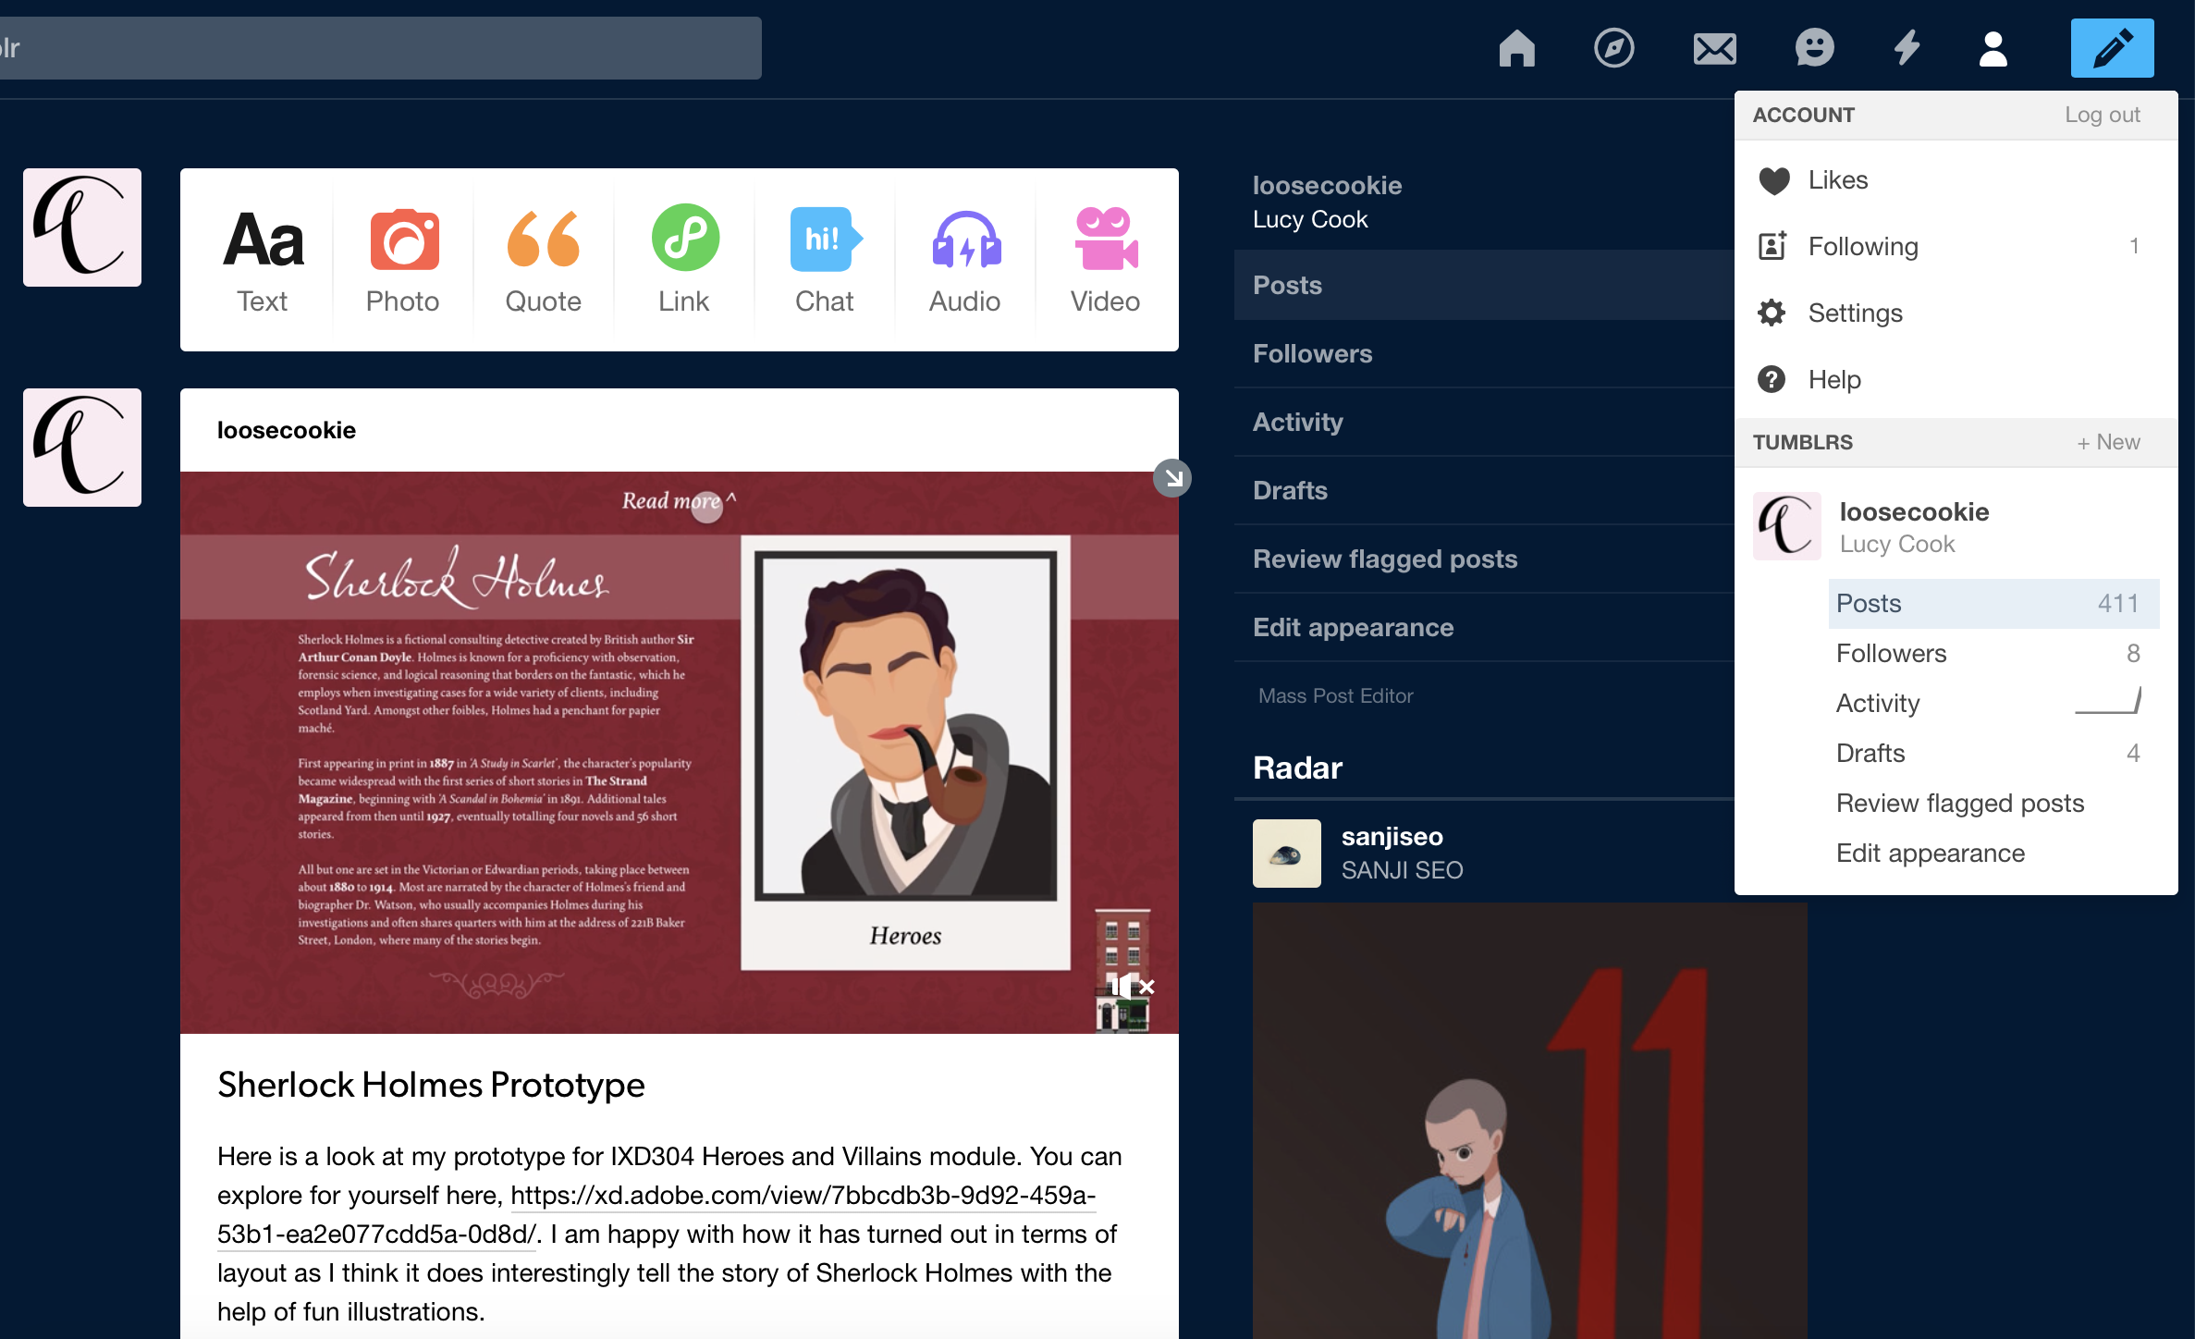
blog
tumblr
In our university course we blog on Tumblr about things we’ve learnt, our research, upload our individual exercises and post links to our final projects. I believe this is a successful method for keeping track of our work and allowing our tutors to access what we’ve been working on. And therefore I think I could incorporate a personal blog for each student, an area were they can upload their thoughts and work for every module.
Notes:
In our university course we blog on tumblr about things we’ve learnt, our research, upload our individual exercises and post links to our final projects.
I believe this is a successful method for keeping track of our work and allowing our tutors to access what we’ve been working on. And therefore I think I could potentially incorporate a personal blog for each student, an area were they can upload their thoughts and work for every module.

Slide 13
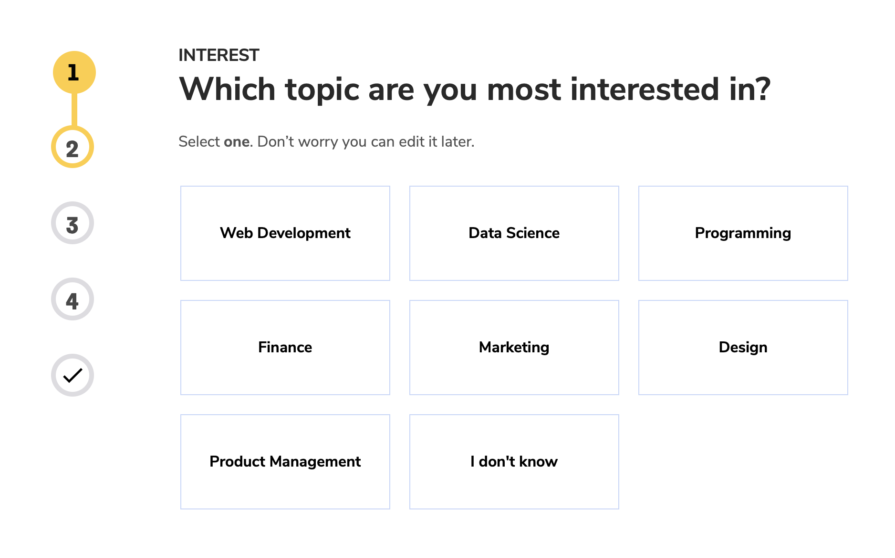
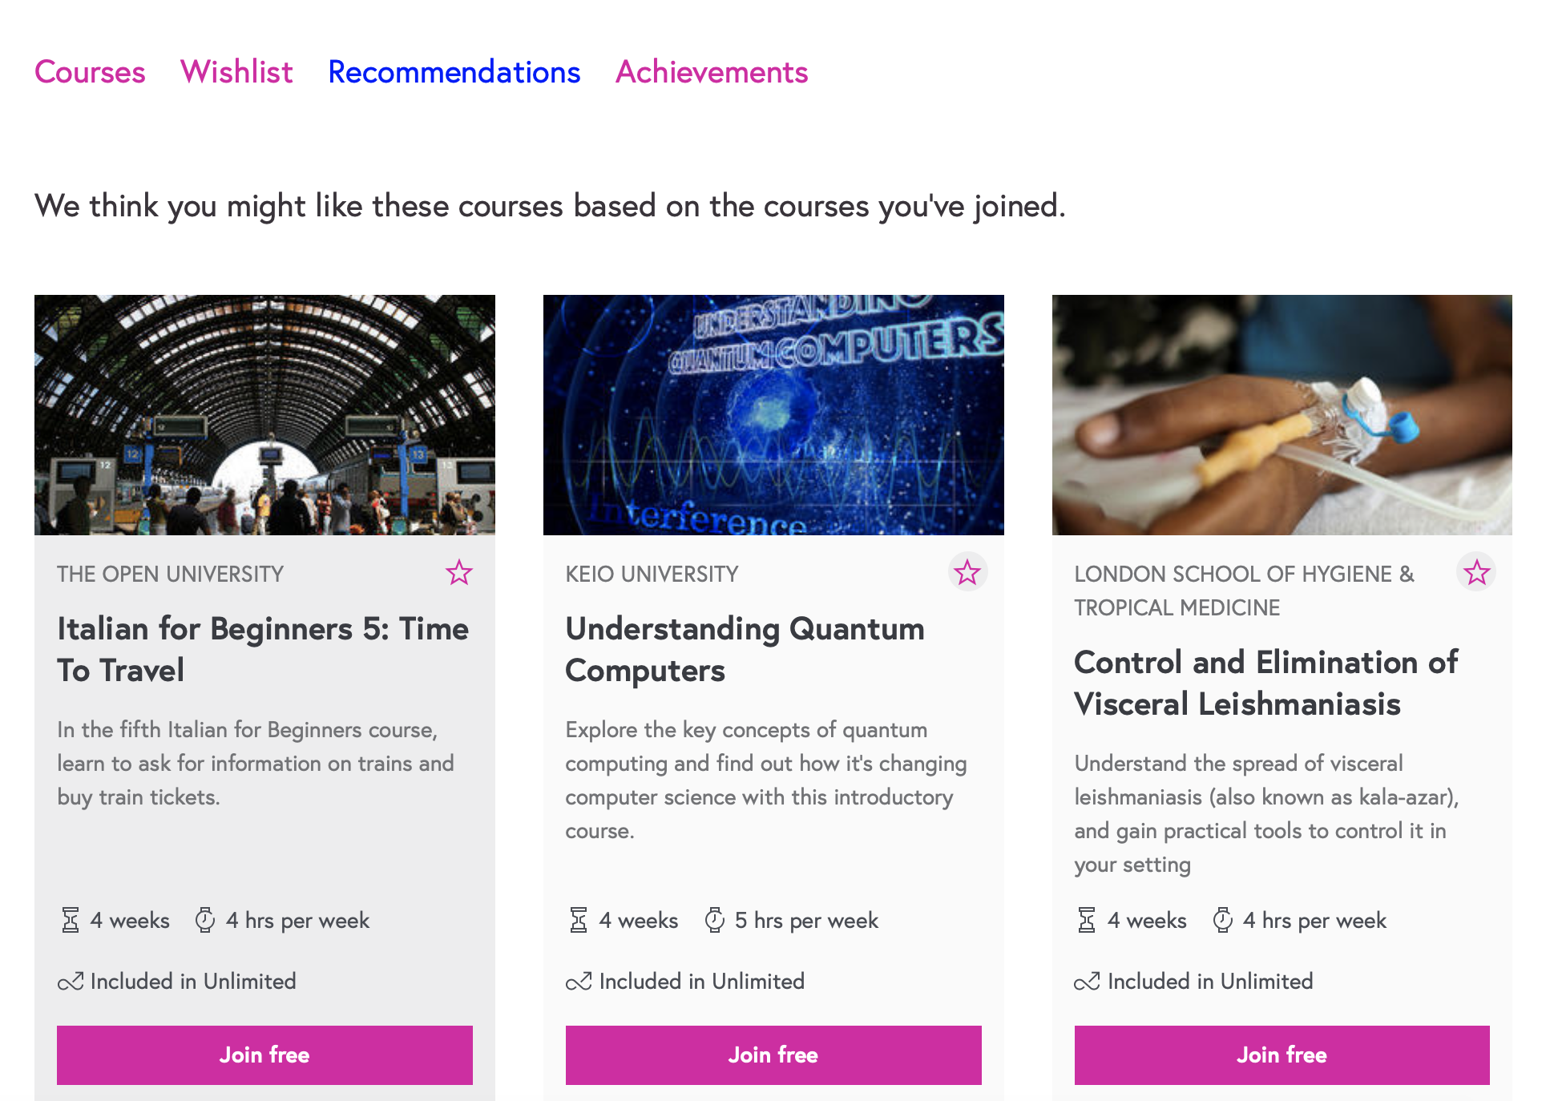
Recommendations
codeacademy
futurelearn
An important feature that many platforms provide is a recommendation section. Similar to what is used on the likes of Amazon and Netflix, online learning platforms can do the same. Codeacademy actually offer a quiz after signing up so that you can be directed straight to modules that are recommended for you.
Notes:
Instagram have a feature were you can save your favourite posts so you can easily find them again in future. This bookmarking idea is something I think would be useful to include in my website, so that users can save those modules they like the sound of but don’t have the time to learn at the minute so instead of losing the link they can save it to their profile section and review at another time.
Duolingo has this feature allowing users that repeatedly return to the app to receive a daily streak, keeping count of every day they return to learn. This is an idea that has developed from Snapchat, has become addictive to users as they don’t want to lose streaks.
An important feature that many platforms provide is a recommendation section, similar to what is used on the likes of Amazon and Netflix.
I believe this is important to encourage students to keep learning, if they are interested in a particular module they’ve already carried out then they may be interested in another module that is similar. Making it easier for users to find favourable modules.
A few of the sites I’ve seen track your progress by using a simple percentage marker which I believe is a good idea to encourage users to keep working through their module. While my pattern concept does incorporate this idea of a progress tracker I think it would also be useful to use to track their current module shown on their profile dashboard.

Slide 14
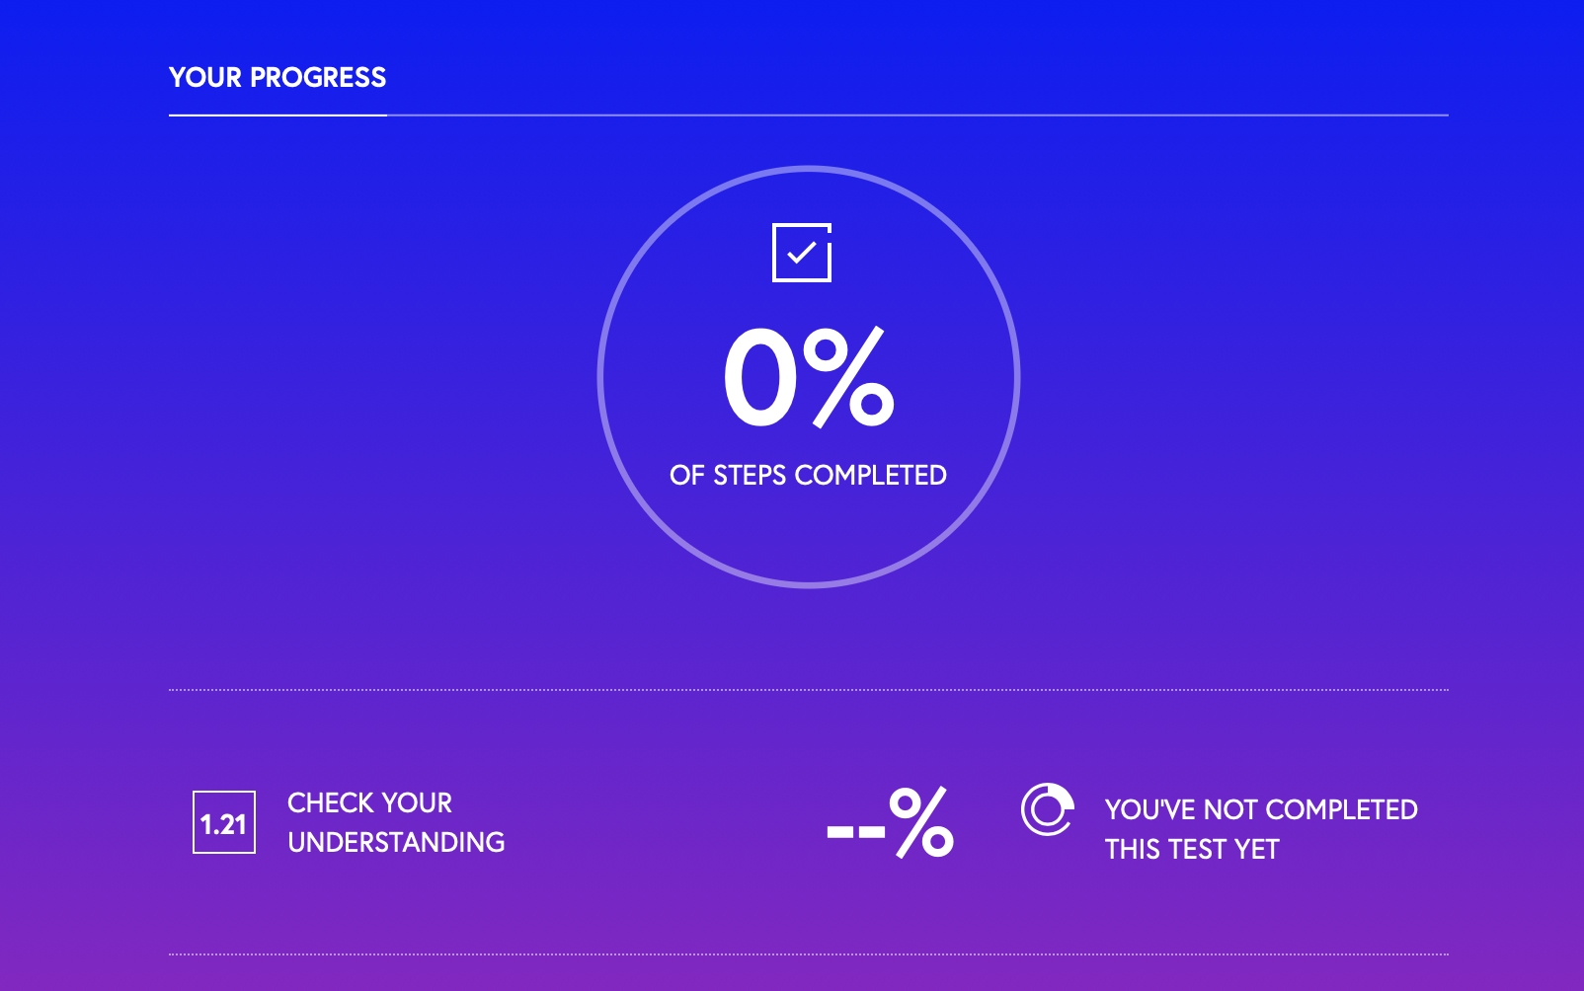
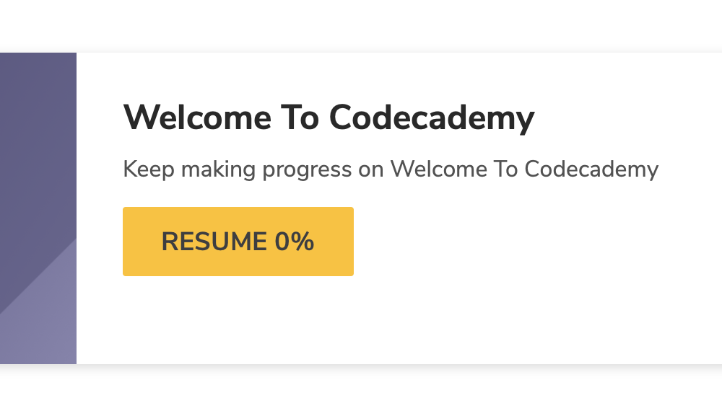
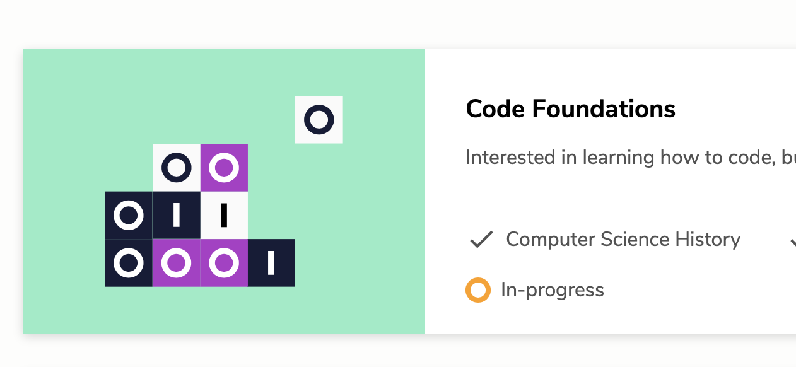
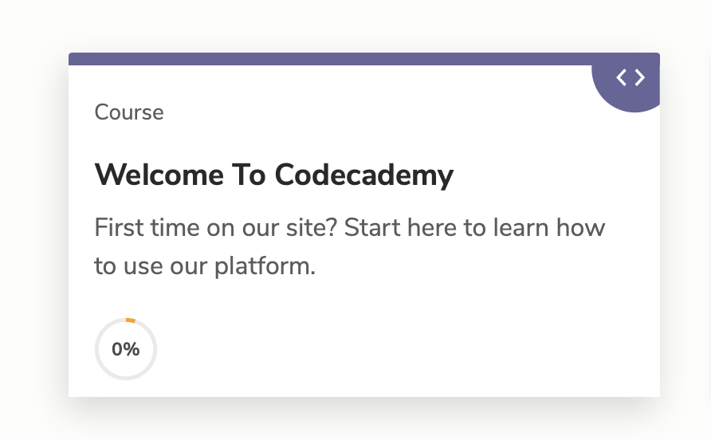
Progress trackers
futurelearn
codeacademy
A few of the sites I’ve seen track your progress by using a simple percentage markers which I believe is a good idea to encourage users to keep working through their module. While my pattern concept does incorporate this idea of a progress tracker I think it would also be useful to use to track individual elements.
Notes:
Instagram have a feature were you can save your favourite posts so you can easily find them again in future. This bookmarking idea is something I think would be useful to include in my website, so that users can save those modules they like the sound of but don’t have the time to learn at the minute so instead of losing the link they can save it to their profile section and review at another time.
Duolingo has this feature allowing users that repeatedly return to the app to receive a daily streak, keeping count of every day they return to learn. This is an idea that has developed from Snapchat, has become addictive to users as they don’t want to lose streaks.
An important feature that many platforms provide is a recommendation section, similar to what is used on the likes of Amazon and Netflix.
I believe this is important to encourage students to keep learning, if they are interested in a particular module they’ve already carried out then they may be interested in another module that is similar. Making it easier for users to find favourable modules.
A few of the sites I’ve seen track your progress by using a simple percentage marker which I believe is a good idea to encourage users to keep working through their module. While my pattern concept does incorporate this idea of a progress tracker I think it would also be useful to use to track their current module shown on their profile dashboard.

Slide 15

Bookmarks and streaks
Instagram
snapchat
duolingo
Instagram have a feature were you can save your favourite posts so you can easily find them again in future. I want to include this bookmark feature so users can save the modules they like the sound of but don’t have the time to learn at the minute so instead of losing the module page they can save it to their profile section and review at another time. Duolingo has the feature allowing users that repeatedly return to the app to receive a daily streak, keeping count of every day they return to learn.
Notes:
Instagram have a feature were you can save your favourite posts so you can easily find them again in future. This bookmarking idea is something I think would be useful to include in my website, so that users can save those modules they like the sound of but don’t have the time to learn at the minute so instead of losing the link they can save it to their profile section and review at another time.
Duolingo has this feature allowing users that repeatedly return to the app to receive a daily streak, keeping count of every day they return to learn. This is an idea that has developed from Snapchat, has become addictive to users as they don’t want to lose streaks.
An important feature that many platforms provide is a recommendation section, similar to what is used on the likes of Amazon and Netflix.
I believe this is important to encourage students to keep learning, if they are interested in a particular module they’ve already carried out then they may be interested in another module that is similar. Making it easier for users to find favourable modules.
A few of the sites I’ve seen track your progress by using a simple percentage marker which I believe is a good idea to encourage users to keep working through their module. While my pattern concept does incorporate this idea of a progress tracker I think it would also be useful to use to track their current module shown on their profile dashboard.

Slide 16
Colour palette
Primary colour palette is made up of yellow and tones of grey layout of my prototype designs, keeping it simplistic. As well as the 6 different colours shown to the right which are used to differentiate the different module categories.
Notes:
Primary colour palette made up of yellow and tones of grey for the structure and background of my prototype keeping it plain a simple then 6 different colours are used to differentiate the different module categories.

Slide 17


brand
UXpert combines UX design and expert. In terms of a logo, I originally sketched and digitalised the light bulb representing fresh ideas that wears a graduation hat which represents the educational aspect. However as I developed my ideas, I came up with a pattern concept and felt this represented my brand better. Yellow is my primary colour which in education represents ‘languages and other creative pursuits’ such as arts which is were design would fall as an overall topic and therefore very relevant.
Notes:
Name: combination of UX design and expert.
Slogan: “Learn the power of UX design”
Logo: originally sketched a number of ideas which finalised into the icon at the top – a light bulb representing fresh ideas that wears a graduation hat which represents the educational aspect.
However as the project went on and I began developing my ideas for how my platform would stand out from the rest, I came up with the pattern concept. I considered changing my logo to represent this pattern shape. Most favourable to the third down.
Colour: A colour that is quite clearly rarely used in the platforms that we looked at was yellow, really only seen by Butter Academy.
I googled how different colours that are used in education, yellow was seen as a colour representing ‘languages and other creative pursuits’ such as arts which is were design would fall as an overall topic. Therefore I felt as though yellow is perhaps an appropriate colour to used as part of my concept’s colour scheme.

Slide 18

Final branding
Notes:
Final Branding

Slide 19
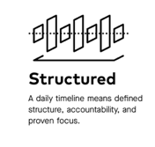



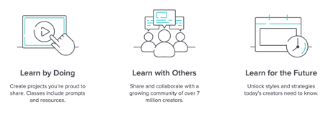
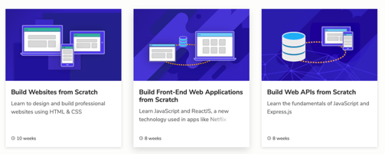


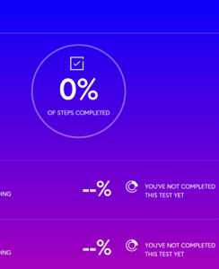
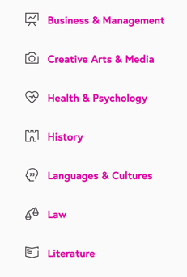
Visual Aesthetics
Collecting a few pieces of visual inspiration from different online learning platforms as well as the likes of Dribbble and other social media platforms. Gathering inspiration for illustrations, navigation bars, iconography, charts and progress trackers.

Slide 20

Element collage
Based on my sketched wireframes, I am building my interface on the basics of these elements. Creating this element collage for the purpose of generating a look and feel for how my prototype will develop into a finished product.

